Slide 1
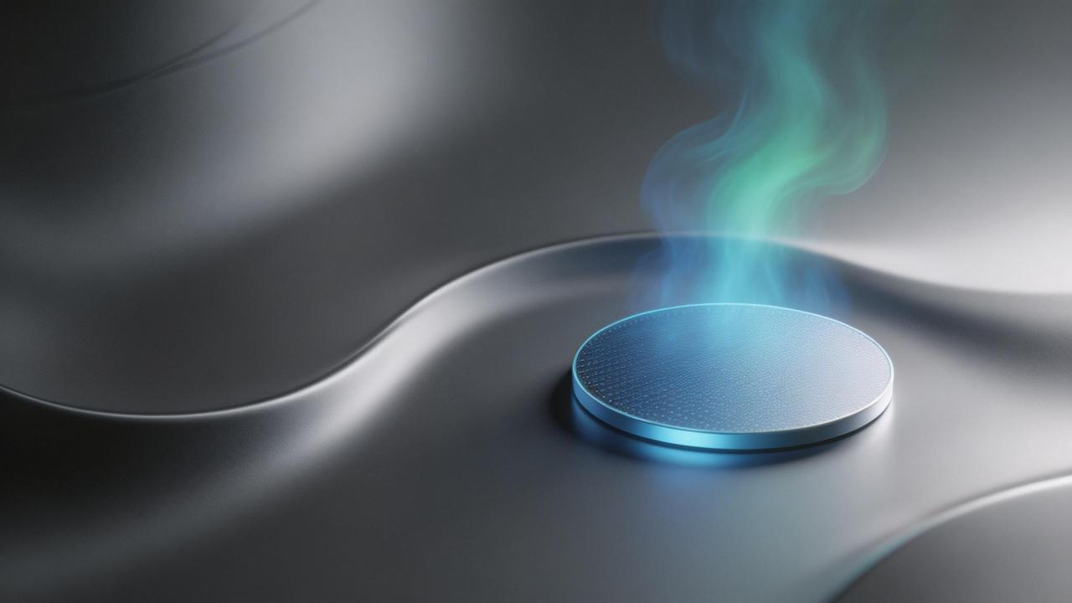

半导体刻蚀硅材料产品说明书
Product Introduction of Semiconductor Etching Silicon Materials
北京中晶创芯半导体科技有限公司
Beijing Jonkin Silicon Technology company Limted

Slide 2
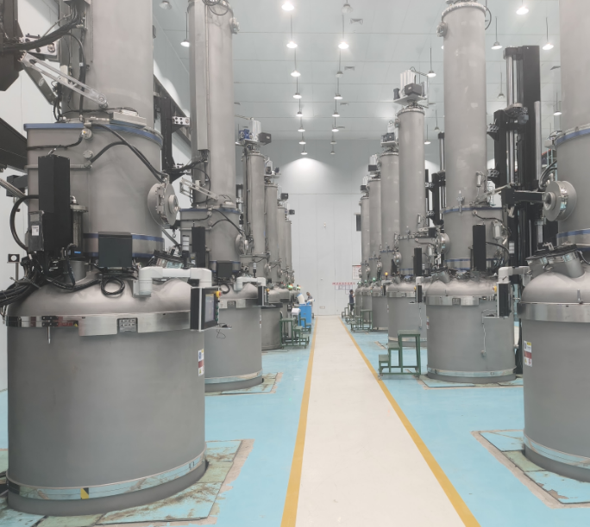
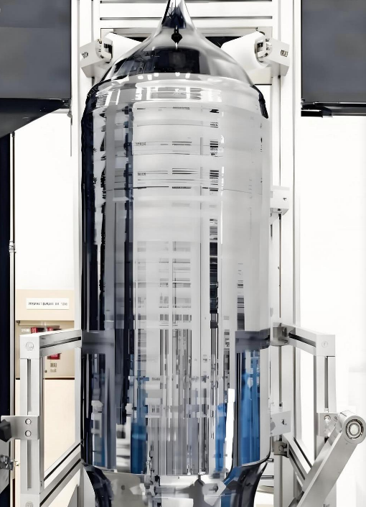
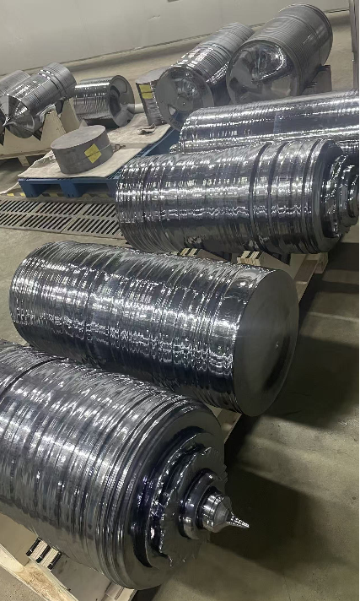
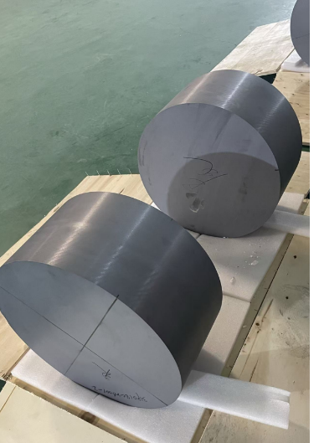
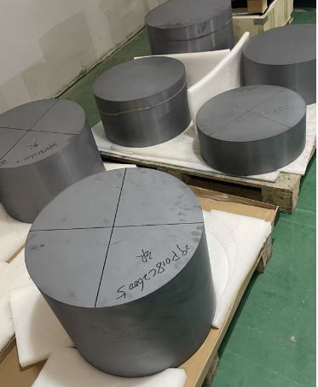
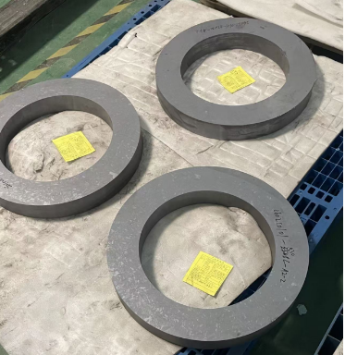
单晶硅产品：原材及半成品 Monocrystalline Silicon Products: Raw Materials & Semi-finished Products
产品规格及系数
生产场景与成品形态
Product Specifications & Coefficients
Production Scenes & Product Forms
No. | 直径 (mm) | 系数 Coeff.
1 | 325 | 0.193
2 | 345 | 0.218
3 | 365 | 0.244
4 | 375 | 0.257
5 | 385 | 0.271
6 | 390 | 0.278
7 | 396 | 0.287
8 | 440 | 0.354
9 | 450 | 0.371
10 | 530-550 | 0.514
11 | 585-600 | 0.626
单晶炉生产区
硅 棒
硅 棒
Single Crystal Furnace Production Area
Silicon Rod
Silicon Rod
产品规格：核心大尺寸500-600mm (16英寸+)刻蚀硅部件 ,基础产品300-450mm (12英寸) 主流规格刻蚀硅部件。
Production Capacity: 34% capacity for large-size high-end products (500-600mm); 66% capacity for large-size high-end products (325-450mm)
硅 锭
硅 锭
硅 环
Silicon Ingot
Silicon Ingot
Silicon Ring
Notes:
大家好，这一页我们介绍单晶硅产品的原材料和半成品。左侧表格展示了我们产品的直径规格和相应系数，覆盖了从325mm到585mm的多种尺寸。我们的产能主要集中在大尺寸高端产品，其中510-600mm规格占34%，325-450mm规格占66%。右侧是我们的生产现场和部分半成品实物图，包括单晶炉生产区、硅棒、硅锭和硅环。我们的核心产品是530-600mm的大尺寸刻蚀硅部件，同时也提供300-400mm的主流规格产品。

Slide 3
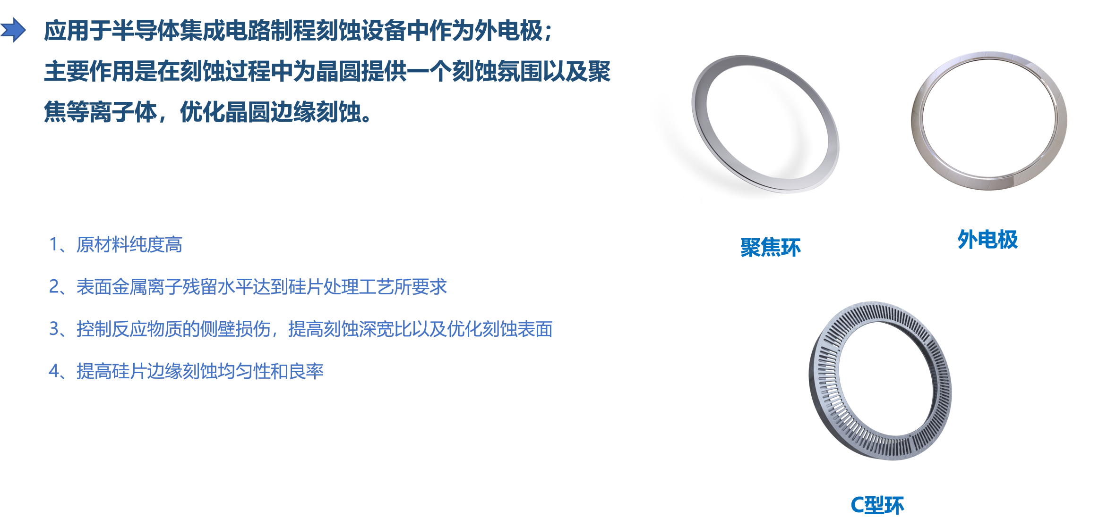
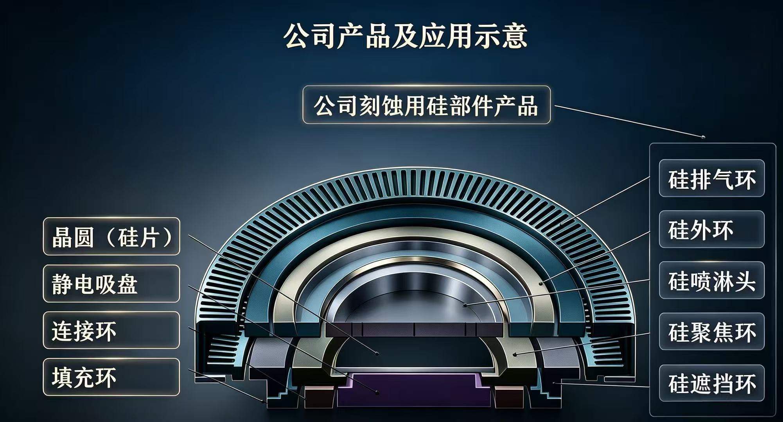
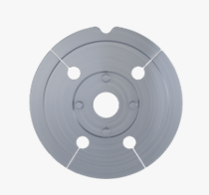
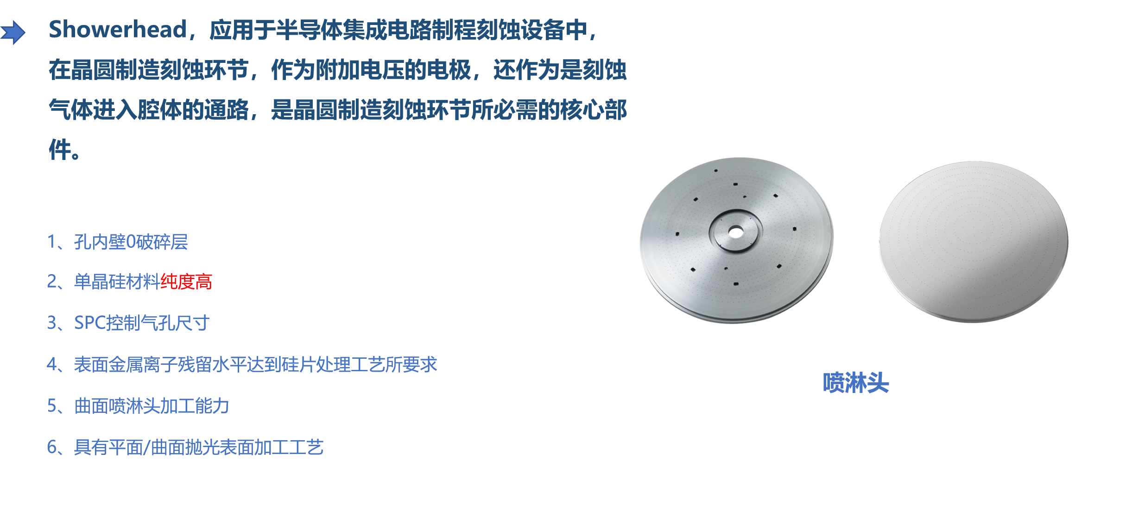
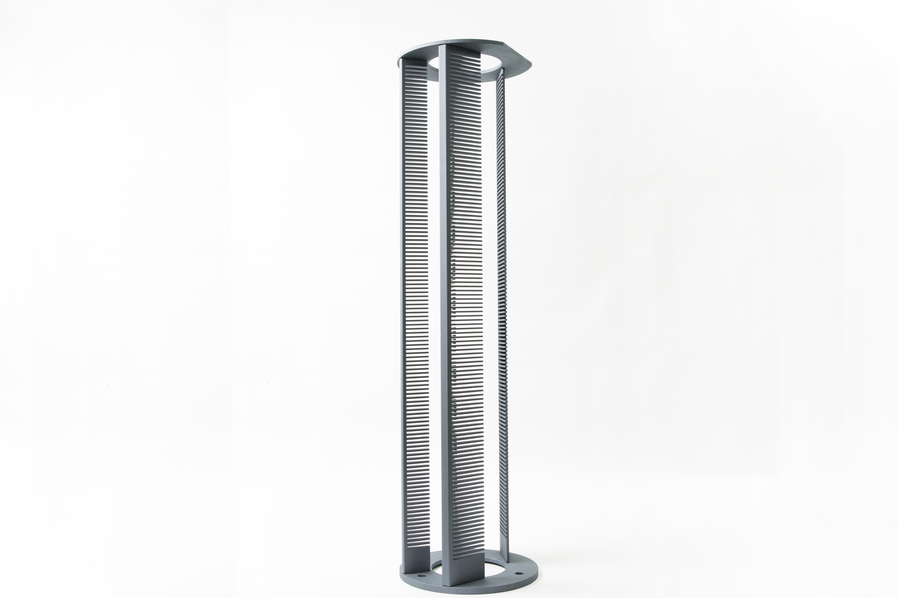
单晶硅产品：成品件 Monocrystalline Silicon Products: Finished Parts
产品应用示意图
尺寸规格范围（主营）：450-600mm
Size Specification Range (Main Products): 450-600mm
Product & Application Schematic Diagram of The Company
硅 C 型环 — Silicon C-Ring ：硅外电极 — Silicon Outer Electrode：
硅聚焦环 — Silicon Focus Ring
应用于半导体集成电路制程刻蚀设备中作为外电极，主要作用是在刻蚀过程中为晶圆提供刻蚀氛围以及聚焦等离子体，优化晶圆边缘刻蚀。
Applied in etching equipment for semiconductor integrated circuit manufacturing as an outer electrode. It provides an etching atmosphere for wafers and focuses plasma during etching, optimizing wafer edge etching.
硅鳍 Silicon Fin
高温炉保温配件，防止低温水珠与高温密封损伤，适配多种湿氧工艺温度需求。
Installed on the base of the insulation barrel in a high-temperature furnace via support pillars. The number of fins is adjustable for different wet oxygen process temperatures. It prevents adverse effects from water droplets at low temperatures and avoids damage to door seals at high temperatures.
单晶硅材料核心特性 | Core Properties
喷淋头 Showerhead
应用于半导体集成电路制程刻蚀设备中在晶圆制造刻蚀环节，作为附加电压的电极，还作为是刻蚀气体进入腔体的通路，是晶圆制造刻蚀环节所必需的核心部件
Applied in etching equipment for semiconductor integrated circuit manufacturing. In the wafer etching process, it acts as an electrode for applied voltage and a passage for etching gas into the chamber, serving as a core component essential for wafer etching.
01 晶体结构完整
Complete Crystal Structure
点阵排列近乎完美，结构稳定性极强，与半导体级硅片同源，为精密加工提供优异的物理基础。
Single crystal structure with nearly perfect lattice arrangement, homologous to semiconductor-grade wafer preparation logic, with strong structural stability.
02 超高纯度低缺陷
Ultra-high Purity & Low Defects
严苛提纯工艺使杂质含量极低，晶格缺陷极少，有效保障了电学性能的一致性与器件的高可靠性。
Single crystal structure with nearly perfect lattice arrangement, homologous to semiconductor-grade wafer preparation logic, with strong structural stability.
03 电阻率定制调控
Customized Resistivity Control
可根据刻蚀工艺需求精准调整电阻率参数，灵活适配不同半导体制造场景的技术指标要求。
Resistivity can be precisely adjusted according to etching process requirements, adapting to technical indicators of different application scenarios.
04 性能全面优异
Superior Performance to Polysilicon
在热导率、化学稳定性及精密加工适配性上均优于多晶硅，能显著提升刻蚀制程的均匀性与良率。
Better physical properties, chemical stability and precision processing adaptability than polysilicon materials.
硅舟 Silicon Boat
承载Si/SiC等晶圆，应用于CVD、氧化、退火等关键制程，耐高温且洁净度高。
Silicon boat is a carrier for wafers (Si/SiC/GaN/GaAs/Ge, etc.). Applied in wafer processing including CVD, oxidation, diffusion, annealing, etc., and is a key component in IC manufacturing
Notes:
接下来，我们看看成品件。我们的核心产品采用行业主流的CZ直拉法制备，确保了高品质的单晶硅棒材。单晶硅材料具有四大核心特性：完整的晶体结构、超高纯度与低缺陷、可定制的电阻率以及优于多晶硅的综合性能。这些特性保证了我们成品件的卓越品质。下方展示了我们的主要成品，包括喷淋头、聚焦环、硅鳍和硅舟，它们都是半导体制造过程中的关键部件。最右侧的示意图展示了这些部件在设备中的具体应用位置。我们的产品在性能和精度上都达到了行业领先水平。

Slide 4





单晶硅产品：技术参数 Technical Parameters
超高硅纯度标准
Ultra-High Silicon Purity Standard
多元化掺杂定
Customized Diversified Doping
全规格电阻率调控
Full-Range Resistivity Tuning
单晶硅纯度优于8N，多晶硅纯度不低于6N。严控杂质至ppb级，保障晶体完整性与电学性能。
Monocrystalline silicon purity superior to 8N, polycrystalline silicon purity ≥6N. Impurities are controlled down to ppb level to guarantee crystal integrity and electrical performance.
支持P型（硼）与N型（磷）定制。精准调整浓度梯度，适配高效光伏与半导体器件。
Supports customized P-type (Boron) and N-type (Phosphorus) doping. Precisely adjust concentration gradients for high-efficiency photovoltaic and semiconductor devices.
覆盖低阻（<0.02 Ω·cm）至高阻（60~90 Ω·cm），精准匹配功率器件、IC等差异化需求。
Covers low resistance (<0.02 Ω・cm) to high resistance (60~90 Ω・cm), accurately meeting differentiated requirements of power devices, ICs and other products.
超平整表面精度 Ultra-Flat Surface Precision
微米级尺寸公差 Micron-Level Dimensional Tolerance
平面度≤15μm，高端版≤8μm，抑制翘曲提升光刻精度。
Flatness ≤15μm; premium version ≤8μm. Warpage suppression improves lithography accuracy.
加工精度控制在±0.05mm以内，极致一致性确保封装与组装高良率。
Machining accuracy controlled within ±0.05mm. Excellent consistency ensures high yield in packaging and assembly.
原子级表面光洁度Atomic-Level Surface Smoothness
外观工艺Surface Appearance Technology
普通面Ra≤0.4μm，抛光面Ra≤0.1μm，降低界面态密度保障稳定性。
Ra ≤0.4 μm for regular surfaces; Ra ≤0.1 μm for polished surfaces. Reduces interface state density and ensures stability.
零缺陷表面无裂纹、崩边及划痕，可定制增强型耐腐蚀涂层，满足苛刻环境要求。
Defect-free surface free of cracks, edge chipping and scratches. Custom enhanced anti-corrosion coatings available to meet harsh etching environment requirements.
严苛金属杂质管控 Metallic Impurities：对 Fe、Cu、Al、Na、Cr 等痕量金属实施 ppb 级严格管控，从原料筛选到制程环境全流程百级净化，从源头杜绝重金属污染风险，确保产品的超高纯度与可靠性。
Stringent ppb-level control over trace metals including Fe, Cu, Al, Na, Cr. Class 100 full-process purification from raw material screening to production environment eliminates heavy metal contamination risks at the source and ensures ultra-high purity and reliability of products
Notes:
接下来，我们看看成品件。我们的核心产品采用行业主流的CZ直拉法制备，确保了高品质的单晶硅棒材。单晶硅材料具有四大核心特性：完整的晶体结构、超高纯度与低缺陷、可定制的电阻率以及优于多晶硅的综合性能。这些特性保证了我们成品件的卓越品质。下方展示了我们的主要成品，包括喷淋头、聚焦环、硅鳍和硅舟，它们都是半导体制造过程中的关键部件。最右侧的示意图展示了这些部件在设备中的具体应用位置。我们的产品在性能和精度上都达到了行业领先水平。

Slide 5
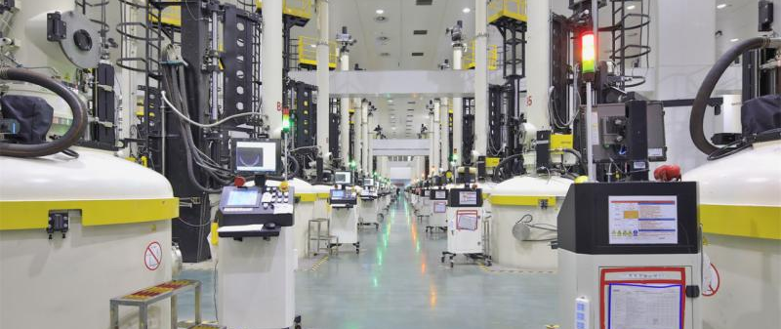
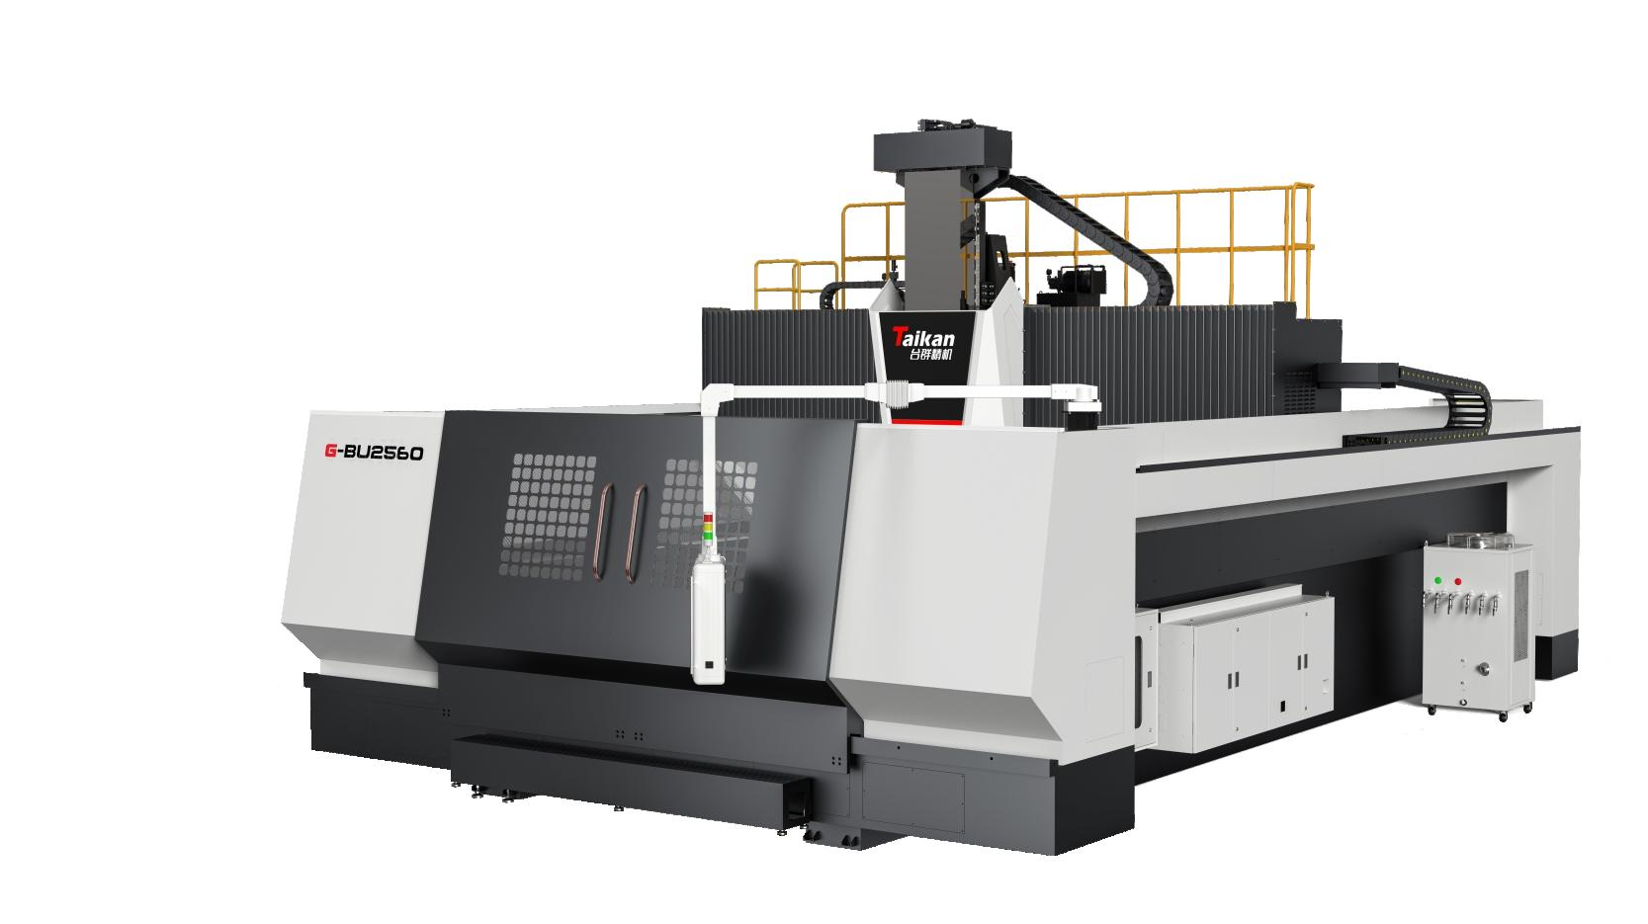
单晶硅产品：生产工艺 Manufacturing Process
我们拥有从硅棒到成品的全链路自主生产能力，通过标准化、自动化的生产流程，严格把控每一个关键环节，确保产品性能的一致性与卓越品质。
We possess full-chain independent production capability from silicon rods to finished products. Through standardized and automated manufacturing procedures, we rigorously control every critical stage to guarantee consistent performance and outstanding quality of products.
01 长晶制造
Crystal Growth Manufacturing
万级洁净车间内，采用直拉法或区熔法，培育高纯度、低缺陷的单晶硅棒，奠定坚实的材料基础。
In Class 10,000 clean workshops, Czochralski (Cz) or Float-Zone (FZ) methods are adopted to grow high-purity, low-defect monocrystalline silicon rods, laying a solid foundation of raw materials.
02 精密加工
Precision Machining
引入五轴CNC数控系统，实现微米级切割与成型，严格控制几何公差，保障器件结构的精准度。
5-axis CNC numerical control systems are deployed to realize micrometer-level cutting and forming. Geometric tolerances are strictly controlled to ensure high precision of component structures.
03 研磨抛光
Grinding & Polishing
采用化学机械抛光(CMP)工艺，将表面粗糙度降至纳米级，打造超光滑镜面，提升表面完整性。
Chemical Mechanical Planarization (CMP) process is applied to reduce surface roughness down to nanometer scale, forming ultra-smooth mirror surfaces and improving surface integrity.
04 超净封装
Ultra-Clean Packaging
在百级无尘环境中完成清洗、干燥与真空密封，彻底去除微颗粒，确保产品洁净与长期稳定。
Cleaning, drying and vacuum sealing are completed in Class 100 dust-free environment to thoroughly remove micro-particles, ensuring product cleanliness and long-term stability.
Notes:
接下来，我们看看成品件。我们的核心产品采用行业主流的CZ直拉法制备，确保了高品质的单晶硅棒材。单晶硅材料具有四大核心特性：完整的晶体结构、超高纯度与低缺陷、可定制的电阻率以及优于多晶硅的综合性能。这些特性保证了我们成品件的卓越品质。下方展示了我们的主要成品，包括喷淋头、聚焦环、硅鳍和硅舟，它们都是半导体制造过程中的关键部件。最右侧的示意图展示了这些部件在设备中的具体应用位置。我们的产品在性能和精度上都达到了行业领先水平。

Slide 6


单晶硅产品：服务与支持 Service & Support
全球顶尖设备兼容
Full Compatibility with World-Class Equipment
01 定制服务Customization Service
可无缝对接 TEL、AMAT、Lam Research 等国际巨头，国内北方华创、中微等国内领军企业设备，确保产线高效集成与稳定运行。
Seamlessly compatible with equipment from international leaders including TEL, AMAT, Lam Research, as well as domestic leading manufacturers such as NAURA and Advanced Micro-Fabrication Equipment, ensuring efficient integration and stable operation of production lines.
提供图纸定制、逆向测绘及旧件复刻等个性化制造服务。针对老旧设备配件缺失、非标准件需求，实现精准匹配与快速生产。
We provide personalized manufacturing services including drawing-based customization, reverse engineering and spare part replication. We deliver precise matching and fast production to solve shortages of spare parts for legacy equipment and non-standard component demands.
全品类制造工艺支持
Full-Range Manufacturing Process Support
02 技术支持Technical Support
深度适配逻辑芯片、存储芯片、功率半导体、MEMS及先进封装干法刻蚀等关键环节，满足多样化工艺的严苛技术要求。
Fully compatible with key processes including logic chips, memory chips, power semiconductors, MEMS and dry etching for advanced packaging, meeting stringent technical requirements of diverse processes.
提供现场安装调试指导与工艺协作支持，开通7×24小时专属技术咨询通道。专业工程师团队随时响应，快速解决技术难题。We offer on-site installation & commissioning guidance and process cooperation support, with a dedicated 7×24-hour technical consultation channel. Our professional engineering team responds promptly to resolve technical challenges efficiently.
多规格晶圆灵活适配
Flexible Adaptation for Multi-Size Wafers
03 质量承诺 Quality Commitment
完美支持 8英寸(200mm)与12英寸以上(300mm)主流晶圆产线，并具备面向未来更大规格产品的定制开发与平滑升级能力。
Fully supports mainstream 8-inch (200 mm) and 12-inch & above (300 mm) wafer production lines, with capabilities for customized development and smooth upgrade for larger-size products in the future.
建立全流程生产记录，实现质量追溯。严格履行退换或返工承诺，并提供终身维护支持。定期回访与设备巡检。
Full-process production records are established to enable complete quality traceability. We strictly abide by return, exchange and rework commitments, provide lifelong maintenance support, and conduct regular follow-up visits and equipment inspections
Notes:
接下来，我们看看成品件。我们的核心产品采用行业主流的CZ直拉法制备，确保了高品质的单晶硅棒材。单晶硅材料具有四大核心特性：完整的晶体结构、超高纯度与低缺陷、可定制的电阻率以及优于多晶硅的综合性能。这些特性保证了我们成品件的卓越品质。下方展示了我们的主要成品，包括喷淋头、聚焦环、硅鳍和硅舟，它们都是半导体制造过程中的关键部件。最右侧的示意图展示了这些部件在设备中的具体应用位置。我们的产品在性能和精度上都达到了行业领先水平。

Slide 7
单晶硅产品：服务与支持 Service & Support
01 洁净操作规范 Cleanroom Operation Specifications
04 工艺验证与量产准入
Process Verification & Mass Production Qualification
操作需在千级或百级洁净环境下进行，全程佩戴无尘手套与口罩，严禁裸手触碰加工表面，杜绝微颗粒污染风险。
Operations shall be performed in Class 1000 or Class 100 clean environment. Cleanroom gloves and masks must be worn at all times. Direct bare-hand contact with machined surfaces is strictly prohibited to eliminate risks of particle contamination.
上机后需依次执行腔体预刻蚀、颗粒基线校准及工艺跑片验证，待刻蚀均匀性、颗粒数等核心指标达标后，方可正式投入量产，确保产品良率稳定。
After loading, perform chamber pre-etching, particle baseline calibration and process wafer run verification sequentially. Formal mass production can only commence once key indicators including etching uniformity and particle count meet standards to stabilize product yield.
02 装配前核对匹配 Pre-Assembly Verification & Matching
安装前仔细核对零件编号、几何尺寸及定位孔位，确认与腔体配件规格完全匹配，避免因型号不符造成装配隐患。
Prior to installation, carefully verify part number, geometric dimensions and positioning holes to ensure full compatibility with chamber components and prevent assembly risks caused by mismatched models.
05 全生命周期监测与维护
Full Lifecycle Monitoring & Maintenance
03 标准装配工艺 Standard Assembly Process
定期检测部件厚度变化及表面腐蚀、磨损程度，建立维护台账；当指标达到更换阈值或出现崩边、裂纹等异常损伤时，需立即停机更换，防止影响工艺稳定性及造成设备损伤。
Regularly inspect component thickness variation, surface corrosion and abrasion, and maintain maintenance records. When parameters reach replacement threshold or chipping, cracking and other abnormal damages occur, shut down equipment for immediate replacement to avoid process instability and equipment damage.
严格控制锁紧力矩，防止硅件因应力集中产生崩裂；彻底清洁密封接触面，确保无异物残留，保障腔体气密性。
Tightening torque shall be strictly controlled to avoid cracking of silicon parts due to stress concentration. Thoroughly clean sealing contact surfaces to eliminate residual contaminants and guarantee chamber airtightness.
01 全项出厂检测
Comprehensive Pre-Delivery Inspection
02 痕量杂质管控
Trace Impurity Control
03 质保与权威认证
Quality Assurance & Authoritative Certification
实施外观无损、表面精度、精密尺寸及电学性能的四维全检，确保零缺陷交付。
Conduct four-dimensional full inspection covering non-destructive appearance check, surface precision, dimensional accuracy and electrical performance to ensure defect-free delivery.
引入高精度质谱设备抽检，执行远严于行业标准的杂质限值，确保材料纯度。
High-precision spectroscopic equipment is adopted for sampling inspection, with impurity limits far stricter than industrial standards to guarantee material purity.
随货附带检测报告(COA)，支持第三方权威复检，为产品质量提供双重背书。
Certificate of Analysis (COA) is provided with each shipment. Authorized third-party re-inspection is supported to deliver dual guarantee for product quality.
Notes:
接下来，我们看看成品件。我们的核心产品采用行业主流的CZ直拉法制备，确保了高品质的单晶硅棒材。单晶硅材料具有四大核心特性：完整的晶体结构、超高纯度与低缺陷、可定制的电阻率以及优于多晶硅的综合性能。这些特性保证了我们成品件的卓越品质。下方展示了我们的主要成品，包括喷淋头、聚焦环、硅鳍和硅舟，它们都是半导体制造过程中的关键部件。最右侧的示意图展示了这些部件在设备中的具体应用位置。我们的产品在性能和精度上都达到了行业领先水平。

